Slide 1
Database Testing

Slide 2
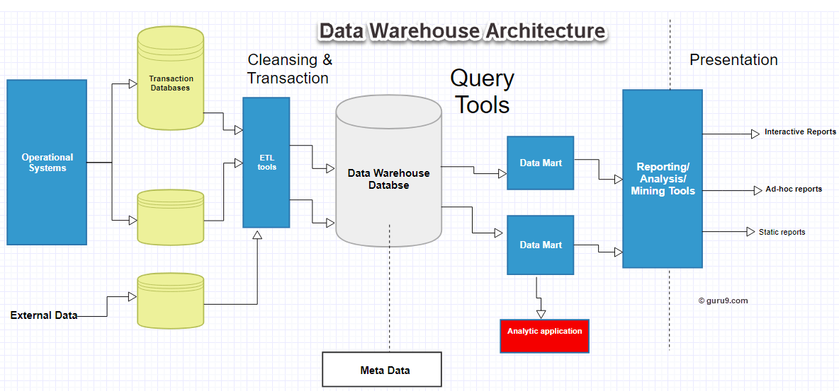
DWH Architecture

Slide 3
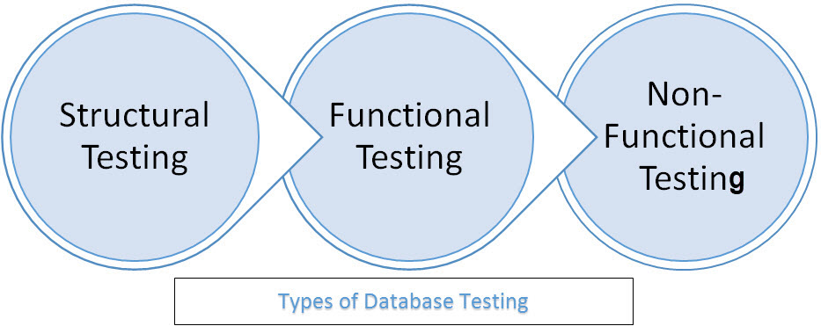
Types of Database Testing
Schema Testing
Metadata Testing
Data Completeness
Data Transformation
Data Quality
Security Testing
Load / Stress Testing

Slide 4
Database Testing Via Front-end
Pick up an existing record, change the values in some fields, and save the record. (It involves the UPDATE statement or update stored procedures and update triggers.)
Insert a new menu item in the front-end window. Fill in the information and save the record. (It involves the INSERT statements or insertion stored procedures and deletion triggers.)
Pick up an existing record, click on the DELETE or REMOVE button, and confirm the deletion. (It involves the DELETE statement or deletion stored procedures and deletion triggers.)
Repeat these test-cases with invalid data and see how the database responds.

Slide 5
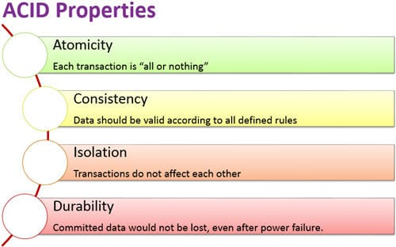
Aspects of Database Transaction

Slide 6
Challenges in DB Testing
Volume of Data
Heterogeneous data source
Data availability for testing in lower environment
Requires complex queries to test transformation

Slide 7
DB Testing Tools
https://www.softwaretestingmagazine.com/tools/open-source-database-testing-tools/
https://www.softwaretestinghelp.com/tools/40-best-database-testing-tools/

